Slide 1
Characterization, Classification and Detection of Fake news
-MUSKAN AGRAWAL
-SHIVANSH SRIVASTAVA
-ZAINAB ZUBAIR

Slide 2
TEAM SUPERVISOR- Ms Vidushi
TEAM LEADER- Zainab Zubair
TEAM MEMBERS- Shivansh Srivastava
Muskan Agrawal

Slide 3
INTRODUCTION
Fake news has been around for decades and is not a new concept. However, the dawn of the social media age has aggravated the generation and circulation of fake news many folds. Fake news can be simply explained as a piece of article which is usually written for economic, personal or political gains.
Many scientists believe that fake news issue may be addressed by means of machine learning and artificial intelligence . Detection of such unrealistic news articles is possible by using various algorithm like Naïve Baye’s , Logistic Regression, SVM ,etc.

Slide 4
OBJECTIVE
The main objective is to detect the fake news, which is a classic text classification problem with a straight forward proposition. It is needed to build a model that can differentiate between “Real” news and “Fake” news

Slide 5
TYPES OF DATA IN SOCIAL MEDIA POSTS
Text: Computational linguistics analyzes text, focusing on the genesis of text semantically and methodically. Because many of the posts are written in the form of texts, much work has been carried out into analyzing them.
Multimedia: Several types of media are combined in a single post. Audio, video, photos, and graphics may all be included. This is highly appealing, because it captures the attention of the visitors without requiring them to read the content.
Hyperlinks: Hyperlinks allow the post's creator to cross-reference to other sources, gaining viewers' trust by confirming the post's genesis. Cross-reference to other social media networking sites, as well as the embedding of photos, is common practice.

Slide 6
TYPES OF FAKE NEWS AND PATTERNS THAT HELP IN DETECTION
Visual Based: These false news posts make extensive use of graphics as compared to content, which may include manipulated photographs, doctored video, or a combination of the two.
User Generated News: This sort of falsified news is generated by phone accounts and is targeted to certain audiences, which might reflect specific age groups, gender, culture, or political affiliations.
Knowledge based: These posts provide scientific (so-called) explanations to some unresolved problems, leading people to feel they are genuine. For example, natural therapies for high blood sugar levels in the human body.
Style based: Pseudo Journalists who impersonate and mimic the style of some accredited journalists write style-based posts.
Stance based: It is a portrayal of true statements in such a way that its meaning and purpose are altered.

Slide 7
HARDWARE REQUIREMENT
Number | Description | Type
1 | Hardware | Processor Intel dual core and above XP / Windows
2 | Clock speed | 3.0 GHz
3 | RAM size | 2048 MB
4 | Hard Disk capacity | 32 GB
SOFTWARE REQUIREMENT
 | Description | Type
1 | Operating System | Windows XP / Windows
2 | Language | Python
3 | IDE | Google Colab Notebook
4 | Browser | Google chrome

Slide 8
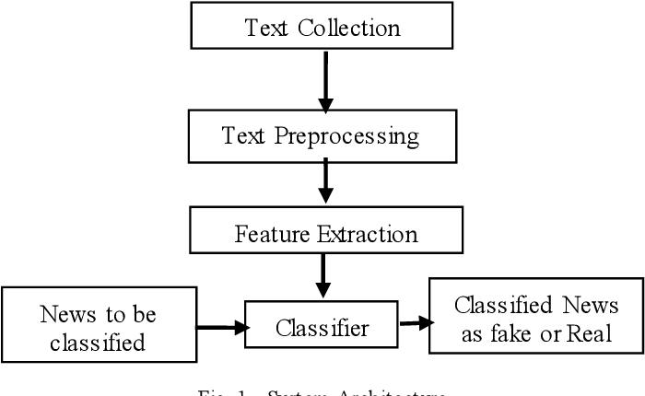
METHODOLOGY
The fake news model detection is built using steps like Text Collection, Text Preprocessing, Feature Extraction and then finally classification using different classifiers.

Slide 9
RESULT AND ANALYSIS
We can evaluate machine learning algorithms using various metrics like:
1. Accuracy
2. Precision
3. Recall
4. F1-Score
Hence we evaluate and analyse the result based on these metrics for different datasets, classifiers and different methods of feature extraction methodology.
Accuracy = (TP+TN)/(TP+FP+FN+TN)
Recall = TP/(TP+FN)
Precision = TP/(TP+FP)
F1 Score = 2*(Recall * Precision) / (Recall + Precision)

Slide 10
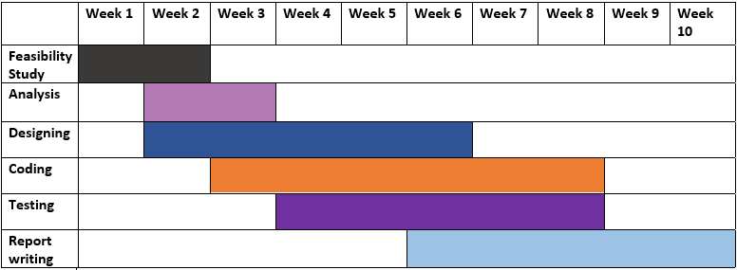
GANTT CHART

Slide 11
CONCLUSION
In the 21st century, the majority of the tasks are done online. Newspapers who were earlier preferred as hard-copies are now being substituted by applications like Facebook, Twitter, and news articles to be read online. The growing problem of fake news only makes things more complicated and tries to change or hamper the opinion and attitude of people towards use of digital technology. Thus, in order to curb the phenomenon, Google and Facebook are taking their steps towards preventing the spread of fake news. Our systems take input from an URL or an existing database and classify it to be true or fake.To implement this, various NLP and Machine Learning Techniques have to be used.

Slide 12
The growing problem of fake news only makes things more complicated and tries to change or hamper the opinion and attitude of people towards use of digital technology.
Our systems take input from a URL or an existing database and classify it to be true or fake.To implement this, various machine learning algorithm techniques have to be used.

Slide 13
THANK YOU!!

